Slide 1
Kubernetes on Azure Stack Hub -the basics
Walter Oliver
@walterov
Program Manager
Azure Stack Hub
April 2020

Slide 2
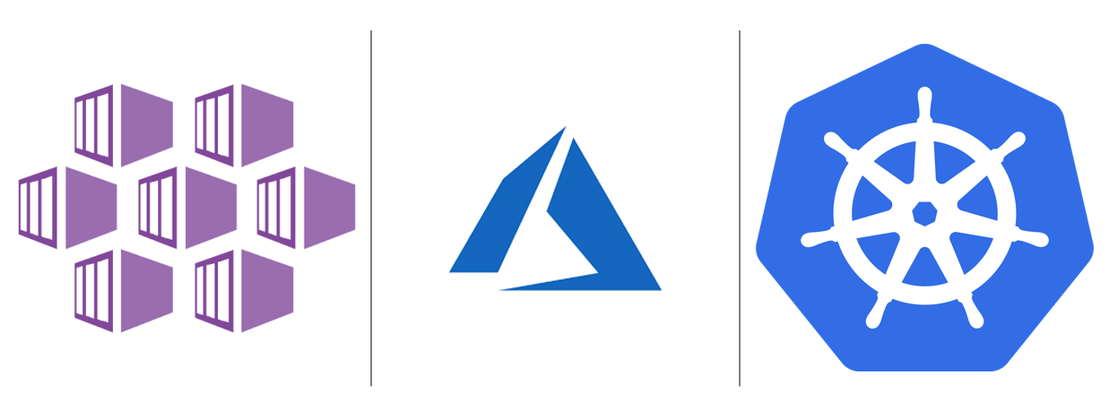
Agenda
Running Kubernetes on Azure Stack Hub
Introductory Demo
How AKS Engine deploys a Kubernetes cluster
Demo AKS engine deploy, update and scale

Slide 3


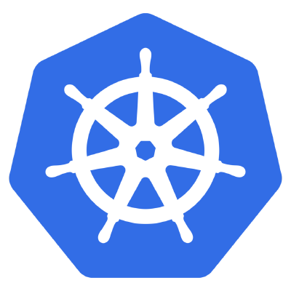
Manage Kubernetes on Azure Stack Hub
AKS Engine is shared tool between Azure and Azure Stack.
Uses Azure Resource Manager natively
OpenShift ARM template available in Github, or manually using
Red Hat’s Ansible scripts
Kubeadm, kubespray, etc. Either manually or with provisioning systems such as Terraform

Slide 4
Demo
Running Cluster with RG and K8s Dashboard
Show it in Arc and Azure Monitor
Show local Monitoring Apps (Prometheus & Grafana)

Slide 5
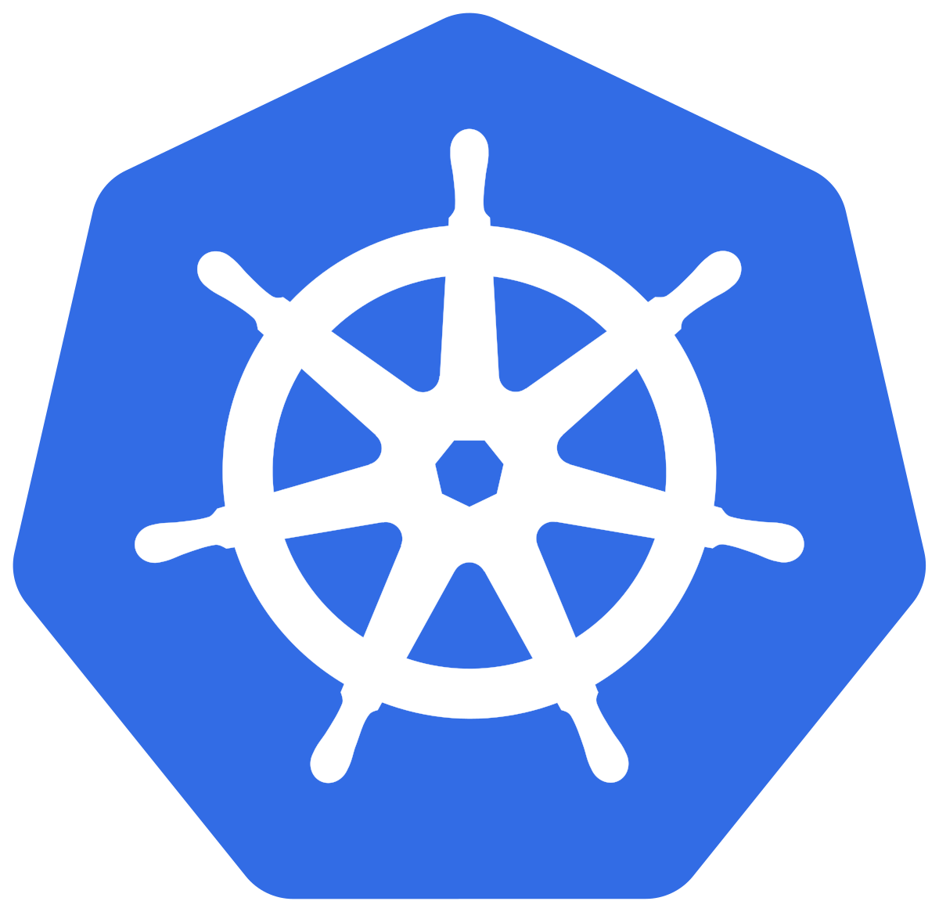
















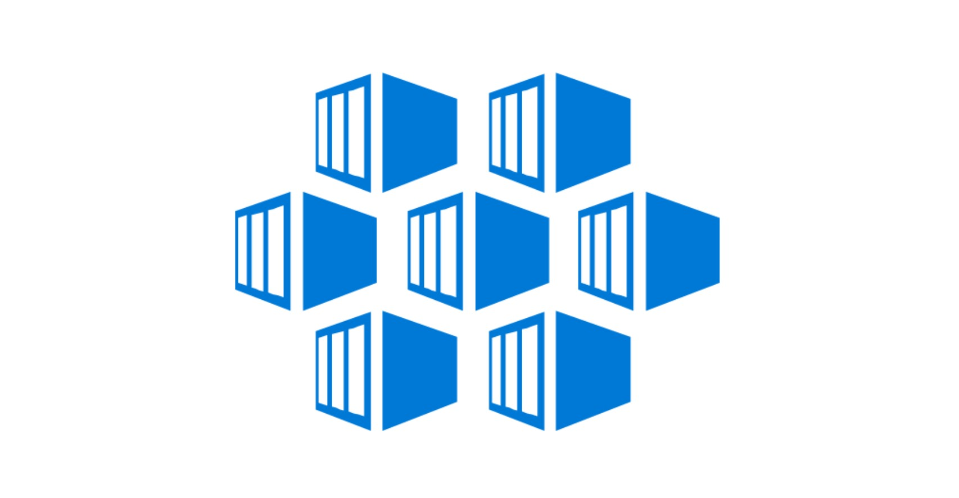
AKS Engine Deploying a K8s Cluster
in Azure Stack Hub
https://aka.ms/aksenginedocs
Azure Stack
Kubernetes
Cloud Provider
K8s Cluster
Admin
K8s Cluster
Users (developers)
Persistent
Volumes
etcd
Upgrade
Scale
AKS Engine
External
Load Balancer
External
Load Balancer
Kubectl
Helm
Kubectl
Helm
AKS Base
VM Image
Persistent
Volumes
Master Nodes
Agent Nodes

Slide 6
AKS Engine Deploy parameters -Demo
aks-engine deploy \
--location orlando \
--api-model ./kubernetes-azurestack.json \
--resource-group cluster00 \
--output-directory cluster00 \
--client-id 1aee903d-xxxx-xxxx-8953-c9d3412755v5 \
--client-secret GddTaxxxxRxxxxzPCJhioeLlVplm1LlkNNML6To5Tw= \
--subscription-id f550f8ba-d8b8-xxxx-b446-bad4a1cc6581 \
--azure-env AzureStackCloud \
--force-overwrite

Slide 7
AKS Engine upgrade/scale cluster
Cluster Lifecycle Operations
Connected/Disconnected
K8’s Version: 1.14
Network Plugin: kubenet
AzS ARM Enpoint: https:…
Master and Agent VMs:
dns prefix,
distro,
size,
Count
Public SSH key: ssh-rsa AAB…
CONFIG DEFAULT VALUES
SECRETS
K8’s Version: 1.15
Network Plugin: kubenet
AzS ARM Enpoint: https:…
Master and Agent VMs:
dns prefix,
distro,
size,
Count (new)
Public SSH key: ssh-rsa AAB…
CONFIG DEFAULT VALUES
SECRETS
Upgrade
or
Scale
AKS Engine
Parameters

Slide 8
AKS Engine Upgrade parameters -Demo
aks-engine upgrade \
--location orlando \
--api-model cluster00/apimodel.json \
--resource-group cluster00 \
--upgrade-version 1.15.8 \
--client-id 5ddx0c0e-xxxx-4ec1-xxxx-17fe2xxcc969 \
--client-secret UbKlUhxxxxxxxPEKs5vxxxylqxuGRZG+xxxxBesHA= \
--subscription-id 1904xe86-af6e-xxxx-xxxx-6faxxe00fd0d \
--azure-env AzureStackCloud \
--force

Slide 9
AKS Engine Scale parameters -Demo
aks-engine scale \
--location orlando \
--resource-group cluster00 \
--subscription-id 902e86-axxxx-4dxxx-8a0-xxxxxxxxxx \
--client-id 5dd70c0e-xxxx-4ec1-8203-17xxxxxxx69 \
--client-secret UlbKlUh3SGdfPEKs5OwFvDylqO4juGRZG+bs99BesHA= \
--api-model cluster00/apimodel.json \
--new-node-count 6 \
--master-FQDN cluster00.orlando.cloudapp.azurestack.corp.microsoft.com \
--azure-env AzureStackCloud

Slide 10
Common questions
Create the Service Principal
Assign the SP with RBAC rights
Create the SSH key
Get the AKS image

Slide 11
References
AKS Engine on Azure Stack Hub documents:
https://docs.microsoft.com/en-us/azure-stack/user/azure-stack-kubernetes-aks-engine-overview
AKS Engine Repo:
https://github.com/Azure/aks-engine
Marketplace item docs:
https://docs.microsoft.com/en-us/azure-stack/user/azure-stack-solution-template-kubernetes-deploy
Walter’s twitter: @walterov

